Slide 1
Introduction to Big Data
Day 6 and 7
Model Application, Feature Engineering, and Evaluation

Slide 2
Day 6 and 7 - Learning Objectives
During Day you will learn to:
Identify some common application areas of analytic models
Describe the purpose of various analytical modeling techniques
Describe model features
Select model features
Describe the purpose of dimension reduction
Evaluate model performance

Slide 3
Application Areas

Slide 4
Application Areas
Applications of Analytic Models
Common areas of functional applications for analytic models include the capability to:
Predict
Forecast
Classify
Cluster
Associate
Sequence
Detect
Diagnose
Describe
Prescribe

Slide 5
Application Areas
Predict
estimate the likelihood that future event or condition will occur
common form of a prediction is in the form of a probability
probabilities may be transformed into scores and likelihood categories to support the needs of decision makers
Forecast
estimate the future value of a continuous variable
common form of a forecast is to position the future value(s) on a timeline
Classify
assign an observation, condition or event to a pre-defined class or category
the observations, conditions or events may be from the past, the present or the future.

Slide 6
Application Areas
Cluster
determine what clusters or categories best describe groups that have common observed behavior
the premise is that the algorithm determines what variables define the boundaries of a given cluster
after the clusters are determined, then conditions or events can be classified into the appropriate cluster
the algorithm is told how many clusters are desired and then the appropriate categories are determined
Associate
determine what events, conditions or items are expected to exist together in combination, given a related context or circumstance
Sequence
determine how events or conditions based on their dependencies exist on a common timeline

Slide 7
Application Areas
Detect
the capability to identify and report an abnormal event or condition
Diagnose
the capability to identify and estimate root causes to a event or condition
root causes are translated into counter measures that can be implemented to reduce the symptoms of a given problem or to prevent the symptoms from re-occurring
Describe
the capability to quantify and describe the behaviors, conditions, activities and outcomes within the context of the domain being studied.
descriptions are further summarized based on descriptive statistics to estimate the measures of central tendency and dispersion within a set of observations
Prescribe
the capability to recommend a course of action based on rules of thumb, simulation methods or optimization techniques

Slide 8
Some tribulations
A big objection to data mining was that it was looking for so many vague connections that it was sure to find things that were bogus
The Rhine Paradox: a great example of how not to conduct scientific research.
David Rhine was a parapsychologist in the 1950’s who hypothesized that some people had Extra-Sensory Perception (ESP).
He devised an experiment where subjects were asked to guess 10 hidden cards --- red or blue.
He discovered that almost 1 in 1000 had ESP --- they were able to get all 10 right!

Slide 9
Example(con’t)
He told these people they had ESP and called them in for another test of the same type.
Alas, he discovered that almost all of them had lost their ESP.
What did he conclude?
You shouldn’t tell people that they have ESP: it causes them to lose it

Slide 10
Example (con’t)
What has really happened:
There are 1024 combinations of red and blue
combinations of red and blue of length 10.
Thus with probability 0.98 at least one person will guess
the sequence of red blue correctly

Slide 11
Machine Learning is not Data Mining
Machine Learning design systems that can learn in the process of processing data
Checkers program designed by one of the scientist eventually learned to play better than the program designer
Data Mining incorporates the Machine learning methods but also benefits from the methods of other disciplines such as database and statistic

Slide 12
What is Data Mining
Data Mining major task is to find all and only interesting patterns in a set of data sources
Find all interesting patterns means – Completeness
Can it be done
Heuristic vs Exhaustive search
Find only interesting patterns – Consistency
Is it possible
Approaches: Generate all patterns and filter out uninteresting patterns; generate only patterns that are interesting

Slide 13
Potential Applications
Database analysis and decision support
Market analysis and management
target marketing, customer relation management, market basket analysis, cross selling, market segmentation
Risk analysis and management
Forecasting, customer retention, improved underwriting, quality control, competitive analysis
Fraud detection and management
Other Applications
Text mining (news group, email, documents) and Web analysis.
Intelligent query answering

Slide 14
Market Analysis and Management (1)
Where are the data sources for analysis?
Credit card transactions, loyalty cards, discount coupons, customer complaint calls, plus (public) lifestyle studies
Target marketing
Find clusters of “model” customers who share the same characteristics: interest, income level, spending habits, etc.
Determine customer purchasing patterns over time
Conversion of single to a joint bank account: marriage, etc.
Cross-market analysis
Associations/co-relations between product sales
Prediction based on the association information

Slide 15
Market Analysis and Management (2)
Customer profiling
data mining can tell you what types of customers buy what products (clustering or classification)
Identifying customer requirements
identifying the best products for different customers
use prediction to find what factors will attract new customers
Provides summary information
various multidimensional summary reports
statistical summary information (data central tendency and variation)

Slide 16
Corporate Analysis and Risk Management
Finance planning and asset evaluation
cash flow analysis and prediction
contingent claim analysis to evaluate assets
cross-sectional and time series analysis (financial-ratio, trend analysis, etc.)
Resource planning:
summarize and compare the resources and spending
Competition:
monitor competitors and market directions
group customers into classes and a class-based pricing procedure
set pricing strategy in a highly competitive market

Slide 17
Fraud Detection and Management (1)
Applications
widely used in health care, retail, credit card services, telecommunications (phone card fraud), etc.
Approach
use historical data to build models of fraudulent behavior and use data mining to help identify similar instances
Examples
auto insurance: detect a group of people who stage accidents to collect on insurance
money laundering: detect suspicious money transactions (US Treasury's Financial Crimes Enforcement Network)
medical insurance: detect professional patients and ring of doctors and ring of references

Slide 18
Fraud Detection and Management (2)
Detecting inappropriate medical treatment
Detecting telephone fraud
Telephone call model: destination of the call, duration, time of day or week. Analyze patterns that deviate from an expected norm.
British Telecom identified discrete groups of callers with frequent intra-group calls, especially mobile phones, and broke a multimillion dollar fraud.
Retail
Analysts estimate that 38% of retail shrink is due to dishonest employees.

Slide 19
Other Applications
Sports
IBM Advanced Scout analyzed NBA game statistics (shots blocked, assists, and fouls) to gain competitive advantage for New York Knicks and Miami Heat
Astronomy
JPL and the Palomar Observatory discovered 22 quasars with the help of data mining
Internet Web Surf-Aid
IBM Surf-Aid applies data mining algorithms to Web access logs for market-related pages to discover customer preference and behavior pages, analyzing effectiveness of Web marketing, improving Web site organization, etc.

Slide 20
Application Areas – Video Content
The following videos provide examples of analytic model applications
Please view these videos to gain a richer perspective
Video from Ted Talks describing how humans play a critical role that complements analytical models
https://www.ted.com/talks/tricia_wang_the_human_insights_missing_from_big_data
Video describing some analytics applications from the energy sector
http://www.mastersindatascience.org/industry/energy/
Applications of Photograph Interpretation from Ted Talks
https://www.youtube.com/watch?v=40riCqvRoMs

Slide 21
Categories of Analytic Models

Slide 22
Categories of Analytic Models
Categories of Models
Analytic models can be classified according some of their key properties
The following groups are commonly used.
Empirical vs Mechanistic
Empirical models are based on relationships from observed data
Mechanistic models are based on relationships based on theory and existing knowledge
Deterministic vs Stochastic
Deterministic models do not consider randomness or uncertainty
Stochastic models do consider elements of randomness and uncertainty
Static vs Dynamic
Static models do not consider the impact of time and the output is generally considered to be at a “point in time”
Dynamic models do consider the impact of time on the output variables.

Slide 23
Categories of Analytic Models
Machine learning, data mining and data science focus on developing empirical models, based on observed data.
Examples of Empirical Modeling Techniques
Supervised Learning Models
Supervised learning models are generated based on defined input variables and a defined output variable, sometimes called a label. The relationships are discovered that best fits a model between the input variables and the relate output variable.
Examples of Supervised Learning Techniques
Regression
Decision Trees
Classification
Unsupervised Learning Models
Unsupervised learning models are generated without a known or defined output variable of label. The algorithms define related variables or features the describe how in combination they provide a group having some common observed behavior.
Examples of Unsupervised Learning Techniques
Clustering
Association
Dimensionality Reduction

Slide 24
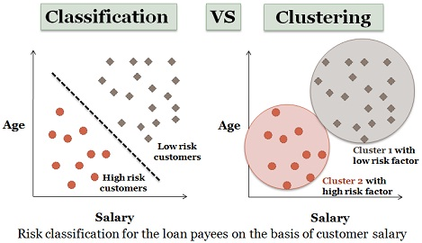

Slide 25
Classification
Given a set of classes, distribute the data into a given set of classes so that a newly arrived data will be with the high probability will fall into one of the classes.
Credit Card example: 4 classes: authorize; request more info; do not authorize; contact police
Data is a set of credit card applications that contain Name, age, credit score, address, income, own or rent primary residence, etc.

Slide 26
Regression
Regression is a process of mapping a given data to some function. Regression may be linear (mapping into a linear function the set of given data or non-linear function.
For example, one may map saving amount to a person age as follows:
samt = a*age+b, where constant a and b are
determined by existing data
Fitting the rest of the data into a defined function should have the least possible error

Slide 27
Time Series Analysis
Given data that changes with time to predict the data behavior based on the known data
Example: predict stock market, predict the stock price of a specific company
Visualization is an important tool of time series analysis
There are special operations on time series that facilitate the time series analysis

Slide 28
Prediction
Differences between Classification and Prediction:
Classification deals with an existing data
Prediction deals with future events
Mathematical Models are normally used for prediction: Weather forecast, quake forecast, etc.

Slide 29
Clustering
Clustering is a process of distributing given data into several sets so that distance between different sets is larger than the distance between elements in the same set
Difference between Clustering and Classification is that the number of clusters is not known in advance, whereas the number of classes is known in advance.
Examples

Slide 30
Association Rules and Sequence Discovery
Association rules discovery relates to uncovering unexpected relationships between data attribute values.
For example people who buy coffee may not buy tee, or man who buy diapers also buy beer. However, women who buy diapers do not buy beer
“Men buy beer and diapers on Fridays”
https://www.theregister.co.uk/2006/08/15/beer_diapers/
Sequence discovery – an ability to determine sequential patterns in the data

Slide 31
Categories of Analytic Models
Videos about Supervised and Unsupervised Learning Methods
https://www.youtube.com/watch?v=cfj6yaYE86U
https://www.youtube.com/watch?v=Ig1nfPjrETc&t=92s
Introduction to Machine Learning
https://www.youtube.com/watch?v=IpGxLWOIZy4
Comparing Supervised and Unsupervised Learning
https://www.youtube.com/watch?v=qDbpYUbf3e0

Slide 32
Model Features

Slide 33
Model Features
Introducing Model Features
In machine learning a feature is an individual measurable property or characteristic of a phenomenon being observed
Choosing informative, discriminating and independent features is a crucial step for effective algorithms in pattern recognition, classification and regression.
Features are usually numeric, but structural features such as strings and graphs are also used.
The concept of "feature" is related to that of explanatory variable used in statistical techniques such as linear regression.
The initial set of raw features can be redundant and too large to be managed.
A preliminary step in machine learning consists of selecting a subset of features or constructing a new and reduced set of features to facilitate learning, and to improve generalization
Extracting or selecting features is a combination of art and science; developing systems to do so is known as feature engineering.
- Source Wikipedia

Slide 34
Model Features - Examples
The following videos provide a conceptual introduction to the concept of model features. Please view the videos to gain this perspective
Introduction to Model Features
https://www.youtube.com/watch?v=yVICmUvy060
What makes a good feature?
https://www.youtube.com/watch?v=N9fDIAflCMY

Slide 35
Feature Engineering

Slide 36
Feature Engineering
The art and science of selecting and/or generating the columns in a data table for a machine learning model.
Not all columns are useful in their raw form.
There are three sub categories of feature engineering, ie. feature selection, dimension reduction and feature generation.
Feature Selection
Process of ranking the attributes by their value to predictive ability of a model.
Algorithms such as decision trees automatically rank the attributes in the data set.
Regression type models usually employ methods such as forward selection or backward elimination to select the final set of attributes for a model.
Dimension Reduction
Sometimes called feature extraction.
A classic example of dimension reduction is principle component analysis or PCA
PCA allows us to combine existing attributes into a new data frame consisting of a much reduced number of attributes by utilizing the variance in the data.
The attributes which "explain" the highest amount of variance in the data form the first few principal components and we can ignore the rest of the attributes if data dimensionality is a problem from a computational standpoint.
PCA results in a data table whose attributes do not look anything like the attributes of the raw dataset.
Feature Generation or Feature Construction
Process of manually constructing new attributes from raw data.
Involves combining or splitting existing raw attributes into new ones which have a higher predictive power.
Examples:
A date stamp may be used to generate 2 new attributes such as AM and PM which may be useful in discriminating whether day or night has a higher propensity to influence the response variable.
Convert noisy numerical attributes into simpler nominal attributes, by calculating the mean value and determining if a given row is above or below that mean value.
Generate a new attribute such as number of claims a member has filed for in a given time period, by combining date attribute and a nominal attribute such as claim_filed (Y/N)
- Source Wikepedia

Slide 37
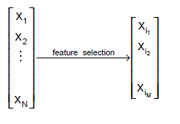
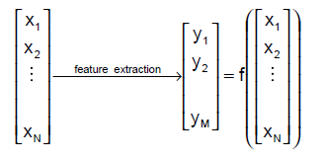
Feature Selection
Given a set of n features, the goal of feature selection is to select a subset of d features (d < n) in order to minimize the classification error.
Fundamentally different from dimensionality reduction (e.g., PCA or LDA) based on feature combinations (i.e., feature extraction).
dimensionality
reduction

Slide 38
Feature Selection vs Dimensionality Reduction
Dimensionality Reduction
When classifying novel patterns, all features need to be computed.
The measurement units (length, weight, etc.) of the features are lost.
Feature Selection
When classifying novel patterns, only a small number of features need to be computed (i.e., faster classification).
The measurement units (length, weight, etc.) of the features are preserved.

Slide 39
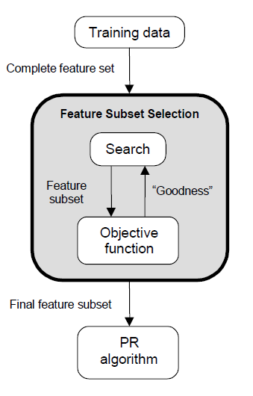
Feature Selection Steps
Feature selection is an optimization problem.
Step 1: Search the space of possible feature subsets.
Step 2: Pick the subset that is optimal or near-optimal with respect to some objective function.

Slide 40
Feature Engineering
The following videos provide Python tutorials on basic ideas related to data preparation and model feature engineering
Please view these videos to learn about feature engineering in Python
Using Jupyter Notebook to show examples of Features and Feature Engineering
https://www.youtube.com/watch?v=V0u6bxQOUJ8
Data Agnostic Approach to Feature Engineering without Domain Expertise
https://www.youtube.com/watch?v=bL4b1sGnILU&t=5s

Slide 41
Dimension Reduction

Slide 42
Dimension Reduction
Dimension Reduction
every potential feature that can be used to predict a dependent variable is defined as a “dimension”
a series of techniques in machine learning and statistics to reduce the number of independent variables or features to consider
works to minimize the loss of information contained in the candidate set of features while creating a simpler model
involves feature selection and feature extraction
simplifies the modeling effort and the models produced

Slide 43
Dimension Reduction
The mathematical details of dimension reduction are beyond the scope of this course
The primary technique used for dimension reduction is called Principal Components Analysis (PCA)
It is used to reduce the number of initial features considered for the model into a smaller set
A component is a weighted sum of the original features that accounts for a given amount of the variation in the dependent variable.
The “principal” components are the set of components that account for an acceptable amount of the variation within the dependent variable

Slide 44
Why Dimensionality Reduction?
It is so easy and convenient to collect data
An experiment
Data is not collected only for data mining
Data accumulates in an unprecedented speed
Data preprocessing is an important part for effective machine learning and data mining
Dimensionality reduction is an effective approach to downsizing data
Notes:
An impromptu experiment: Feel free to write down the most relevant words/phrases describing this lecture hall or classroom; A summary of the words/phrases; Possible tasks of using these words/phrases (Differentiate this kind of rooms from others, Characterize all similar rooms

Slide 45
Why Dimensionality Reduction?
Most machine learning and data mining techniques may not be effective for high-dimensional data
Curse of Dimensionality
Query accuracy and efficiency degrade rapidly as the dimension increases.
The intrinsic dimension may be small.
For example, the number of genes responsible for a certain type of disease may be small.

Slide 46
Why Dimensionality Reduction?
Visualization: projection of high-dimensional data onto 2D or 3D.
Data compression: efficient storage and retrieval.
Noise removal: positive effect on query accuracy.

Slide 47
Application of Dimensionality Reduction
Customer relationship management
Text mining
Image retrieval
Microarray data analysis
Protein classification
Face recognition
Handwritten digit recognition
Intrusion detection

Slide 48

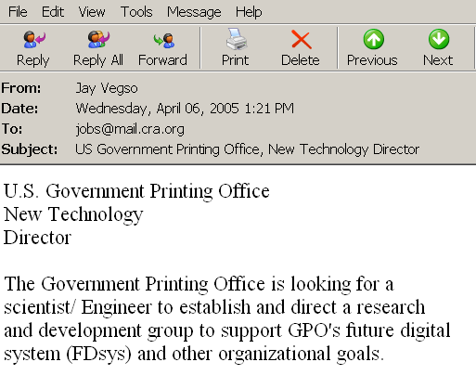


Document Classification
Terms
Web Pages
Emails
T₁ T₂ ….…… T_{N}
C
Sports
12 0 ….…… 6
D₁
D₂
Travel
3 10 ….…… 28
Documents
…
…
…
…
D_{M}
0 11 ….…… 16
Jobs
Internet
Task: To classify unlabeled documents into categories
Challenge: thousands of terms
Solution: to apply dimensionality reduction
ACM Portal
IEEE Xplore
PubMed
Digital Libraries
Notes:
Massive volume of data, categories (sports, travel), normally regarded as a bag of words, c is category, classification task, a moderate sized collection of documents, effects of irrelevant and redundant features, feature selection

Slide 49
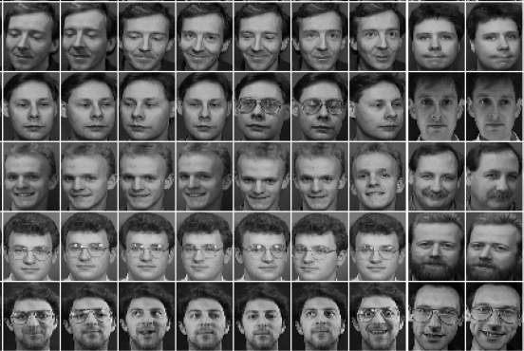
Other Types of High-Dimensional Data
Face images
Handwritten digits

Slide 50
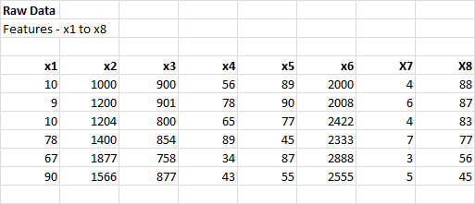
Dimension Reduction – Simple Example
Original Data Set – 8 Potential Features

Slide 51
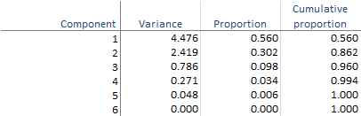
Dimension Reduction – Simple Example
Results of Principal Components Analysis
Components 1 to 4 account
for 99.4% of the variation
Components 1 to 6
Four components can be
used as features instead of six
This means there are four principal components

Slide 52
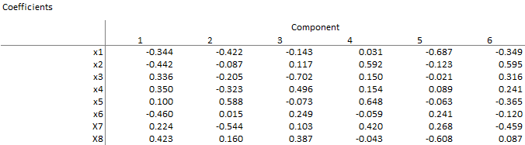
Dimension Reduction – Simple Example
Description of Each Component
Note:
Component 1 = Coeff 1 * X1 + Coeff 2 * X2 + Coeff 3 * X3…… + Coeff n * Xn
Using transformations, selected components can be used as model features
Based on 4 Principal Components, a simpler model emerges

Slide 53
Dimension Reduction
Introduction to the need for Dimension Reduction
https://www.youtube.com/watch?v=9fVSJVp11xc&index=1&list=PLnnr1O8OWc6aVexn2BY0qjklobY6TUEIy
How visualization benefits from Dimension Reduction
https://www.youtube.com/watch?v=MR8sWzoUUwM&index=2&list=PLnnr1O8OWc6aVexn2BY0qjklobY6TUEIy

Slide 54
Perspectives: Selection Criteria
Consistency Measures.
They attempt to find a minimum number of features that separate classes as the full set of features can.
They aim to achieve P(C|FullSet) = P(C|SubSet).
An inconsistency is defined as the case of two examples with the same inputs (same feature values) but with different output feature values (classes in classification).

Slide 55
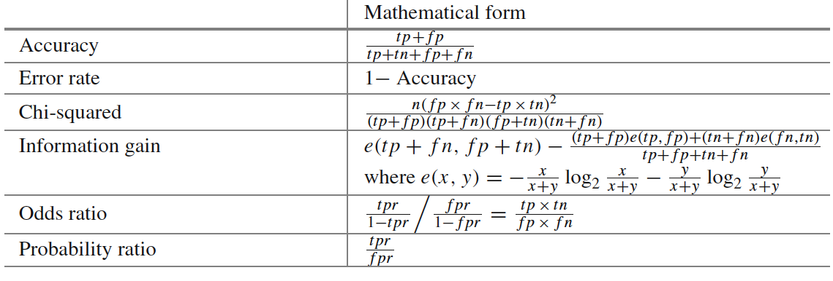
Perspectives: Selection Criteria
Accuracy Measures.
This form of evaluation relies on the classifier or learner. Among various possible subsets of features, the subset which yields the best predictive accuracy is chosen

Slide 56
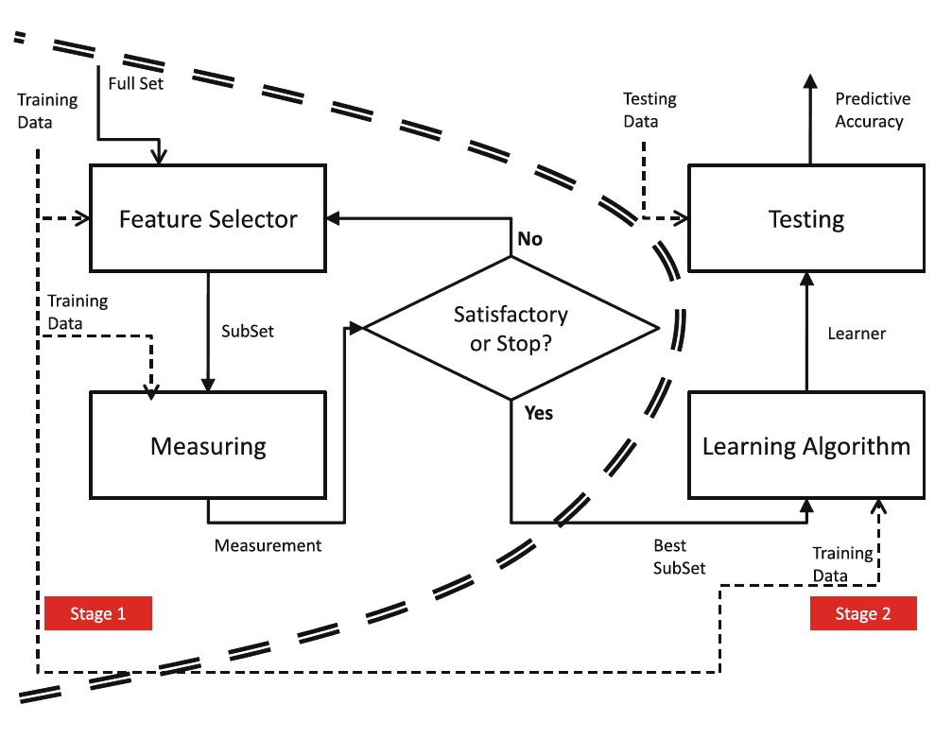
Perspectives
Filters:

Slide 57
Perspectives
Filters:
measuring uncertainty, distances, dependence or consistency is usually cheaper than measuring the accuracy of a learning process. Thus, filter methods are usually faster.
it does not rely on a particular learning bias, in such a way that the selected features can be used to learn different models from different DM techniques.
it can handle larger sized data, due to the simplicity and low time complexity of the evaluation measures.

Slide 58
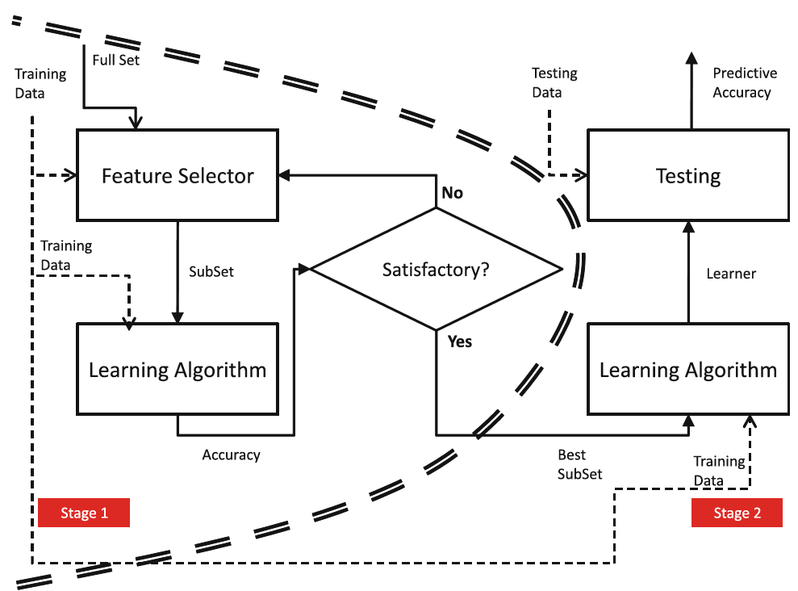
Perspectives
Wrappers:

Slide 59
Perspectives
Wrappers:
can achieve the purpose of improving the particular learner’s predictive performance.
usage of internal statistical validation to control the overfitting, ensembles of learners and hybridizations with heuristic learning like Bayesian classifiers or Decision Tree induction.
filter models cannot allow a learning algorithm to fully exploit its bias, whereas wrapper methods do.

Slide 60
Perspectives
Embedded FS:
similar to the wrapper approach in the sense that the features are specifically selected for a certain learning algorithm, but in this approach, the features are selected during the learning process.
they could take advantage of the available data by not requiring to split the training data into a training and validation set; they could achieve a faster solution by avoiding the re-training of a predictor for each feature subset explored.

Slide 61
Aspects: Output of Feature Selection
Feature Ranking Techniques:
we expect as the output a ranked list of features which are ordered according to evaluation measures.
they return the relevance of the features.
For performing actual FS, the simplest way is to choose the first m features for the task at hand, whenever we know the most appropriate m value.

Slide 62
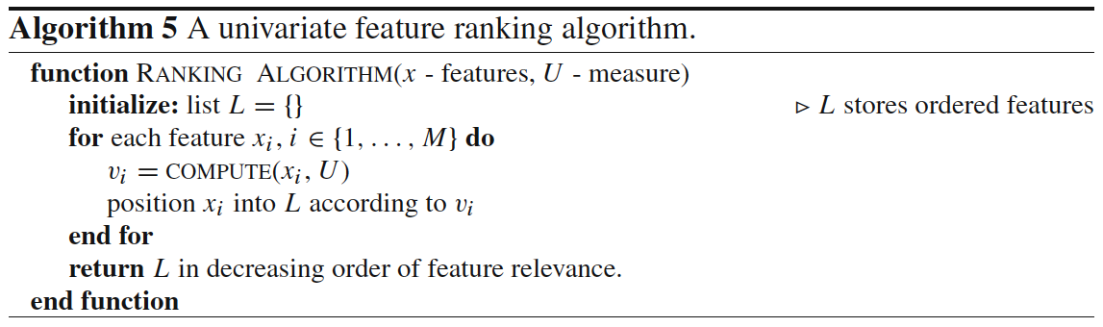
Aspects: Output of Feature Selection
Feature Ranking Techniques:

Slide 63
Aspects: Evaluation
Goals:
Inferability: For predictive tasks, considered as an improvement of the prediction of unseen examples with respect to the direct usage of the raw training data.
Interpretability: Given the incomprehension of raw data by humans, DM is also used for generating more understandable structure representation that can explain the behavior of the data.
Data Reduction: It is better and simpler to handle data with lower dimensions in terms of efficiency and interpretability.

Slide 64
Model Evaluation

Slide 65
Definition
“Evaluation models either describe what evaluators do or prescribe what they should do” (Alkin and Ellett, 1990, p.15)

Slide 66
When?
Early and often
Before it is too late

Slide 67
Revise Instruction
Conduct Instructional Analysis
Assess Needs to Identify Goals
Write Performance Objectives
Develop Assessment Instruments
Develop Instructional Strategy
Develop and Select Instructional Materials
Design and Conduct Formative Evaluation
Analyze Learners and Contexts
Design and Conduct Summative Evaluation
The Dick and Carey Model

Slide 68
What questions to be answered?
Feasibility: Can it be implemented as it is designed?
Usability: Can “we” actually use it?
Appeal: Do “we” like it?
Effectiveness: Will “we” get what is supposed to get?
“we” the stakeholders.

Slide 69
Strategies
Expert review
Content experts: the scope, sequence, and accuracy of the program’s content
Instructional experts: the effectiveness of the program
Graphic experts: appeal, look and feel of the program
Notes:
Experts: content, SME, graphic designers, teaching and training experts
Accuracy, completeness, user-freiendliness, effectiveness, efficiency, and feasibility
User: target audience, observations and interviewing

Slide 70
Strategies II
User review
A sample of targeted learners whose background are
similar to the final intended users;
Observations: users’ opinions, actions, responses, and suggestions

Slide 71
Strategies III
Field tests
Alpha or Beta tests

Slide 72
Who is the evaluator?
Internal
Member of design and development team

Slide 73
When to stop?
Cost
Deadline
Sometimes, just let things go!

Slide 74
Why Evaluate?
Multiple methods are available to classify or predict
For each method, multiple choices are available for settings
To choose best model, need to assess each model’s performance

Slide 75
Accuracy Measures (Classification)

Slide 76
Misclassification error
Error = classifying a record as belonging to one class when it belongs to another class.
Error rate = percent of misclassified records out of the total records in the validation data

Slide 77
Naïve Rule
Naïve rule: classify all records as belonging to the most prevalent class
Often used as benchmark: we hope to do better than that
Exception: when goal is to identify high-value but rare outcomes, we may do well by doing worse than the naïve rule (see “lift” – later)

Slide 78
Separation of Records
“High separation of records” means that using predictor variables attains low error
“Low separation of records” means that using predictor variables does not improve much on naïve rule

Slide 79
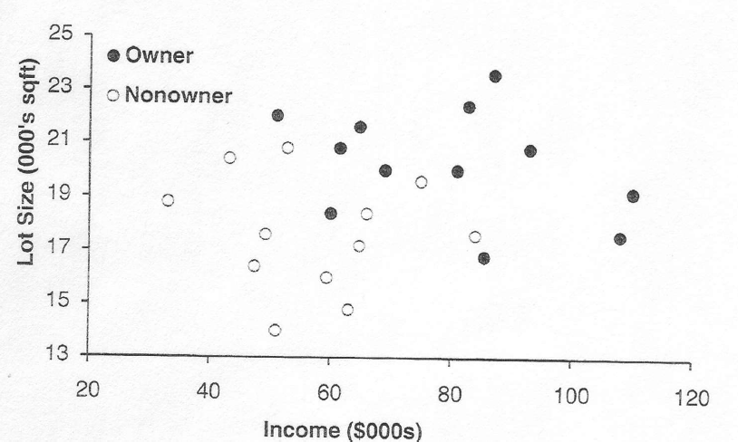
High Level of Separation Between Classes

Slide 80
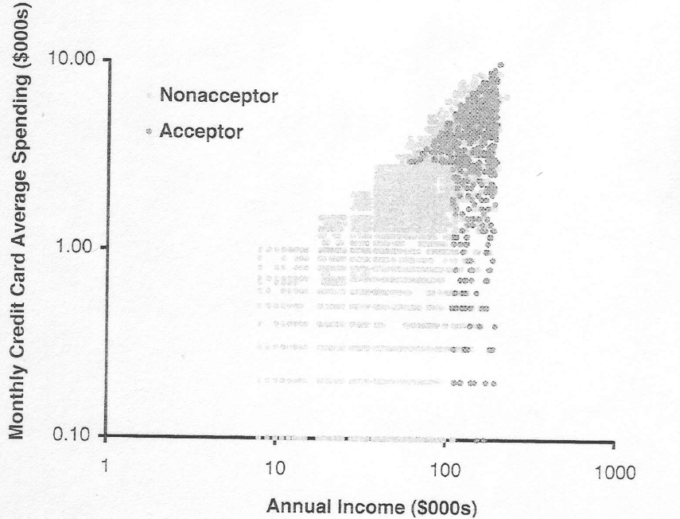
Low Level of Separation Between Classes

Slide 81
Confusion Matrix
201 1’s correctly classified as “1”
85 1’s incorrectly classified as “0”
25 0’s incorrectly classified as “1”
2689 0’s correctly classified as “0”

Slide 82
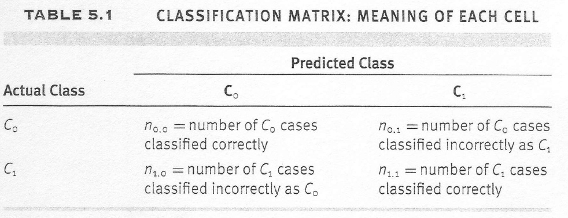

Slide 83
Error Rate
Overall error rate = (25+85)/3000 = 3.67%
Accuracy = 1 – err = (201+2689) = 96.33%
If multiple classes, error rate is:
(sum of misclassified records)/(total records)

Slide 84
Cutoff for classification
Most DM algorithms classify via a 2-step process:
For each record,
Compute probability of belonging to class “1”
Compare to cutoff value, and classify accordingly
Default cutoff value is 0.50
If >= 0.50, classify as “1”
If < 0.50, classify as “0”
Can use different cutoff values
Typically, error rate is lowest for cutoff = 0.50

Slide 85
Cutoff Table
If cutoff is 0.50: 13 records are classified as “1”
If cutoff is 0.80: seven records are classified as “1”

Slide 86
Confusion Matrix for Different Cutoffs

Slide 87
When One Class is More Important
In many cases it is more important to identify members of one class
Tax fraud
Credit default
Response to promotional offer
Detecting electronic network intrusion
Predicting delayed flights
In such cases, we are willing to tolerate greater overall error, in return for better identifying the important class for further attention

Slide 88
Alternate Accuracy Measures
If “C₁” is the important class,
Sensitivity = % of “C₁” class correctly classified
Sensitivity = n_{1,1} / (n_{1,0}+ n_{1,1} )
Specificity = % of “C₀” class correctly classified
Specificity = n_{0,0} / (n_{0,0}+ n_{0,1} )
False positive rate = % of predicted “C₁’s” that were not “C₁’s”
False negative rate = % of predicted “C₀’s” that were not “C₀’s”

Slide 89
Model Evaluation
Please review the following videos to get an appreciation of how to evaluate a machine learning model.
Train /Test Splitting Your Data
https://www.youtube.com/watch?v=VcSNDMBTE-s
Testing and Error Metrics
https://www.youtube.com/watch?v=aDW44NPhNw0

Slide 90
Lesson Summary

Slide 91
Day 6 and 7 Lesson Summary
During Day 6 and 7 you learned to:
Identify some common application areas of analytic models
Describe the purpose of various analytical modeling techniques
Describe model features
Select model features
Describe the purpose of dimension reduction
Evaluate model performance

